Slide 1
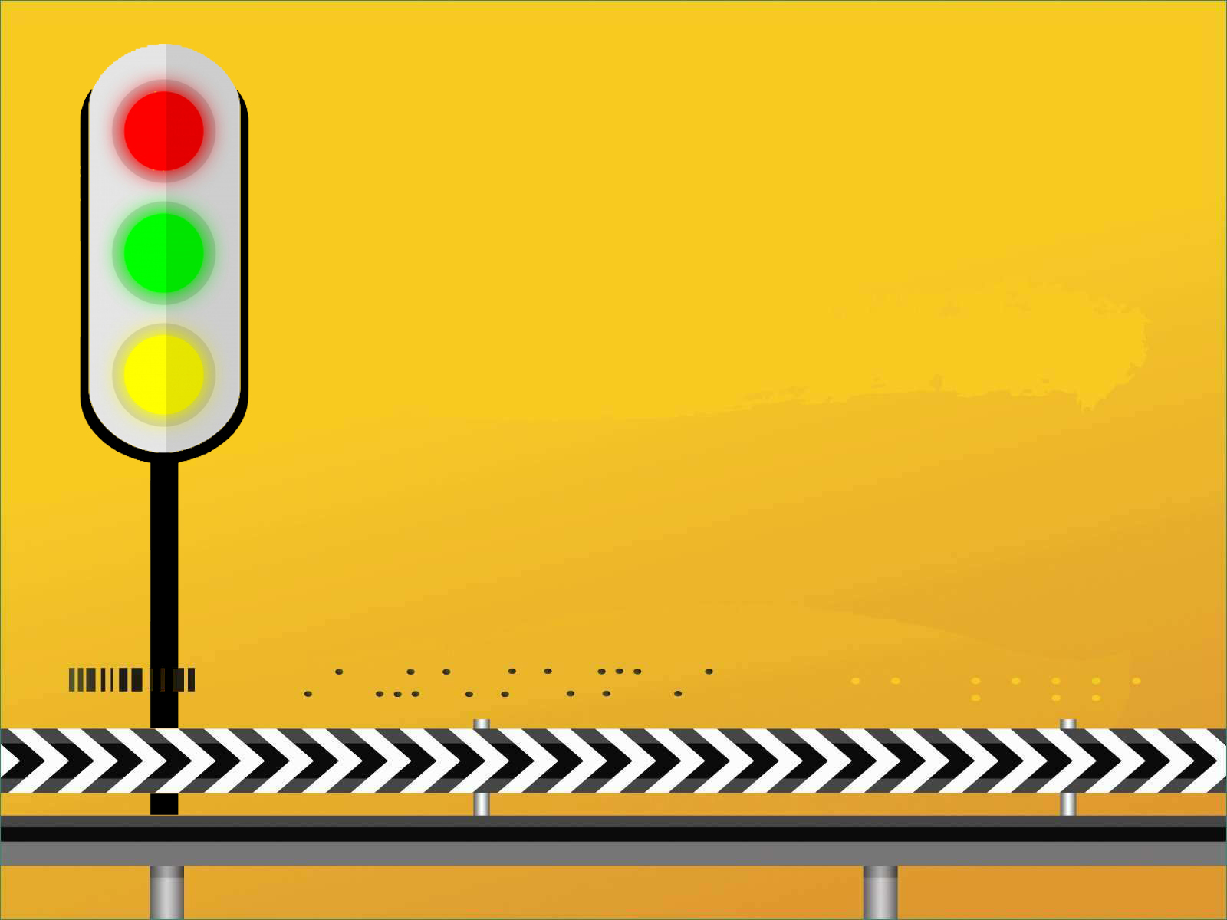
Road Safety

Slide 2
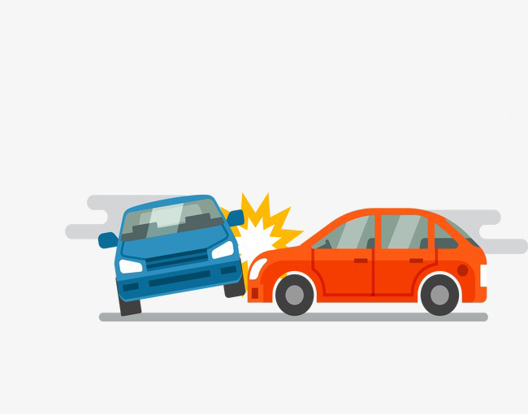
Problem Statement
Road Safety using Smart Lights and Smart Traffic Control System

Slide 3
iLighto
Intelligent Light System

Slide 4
Working

Slide 5

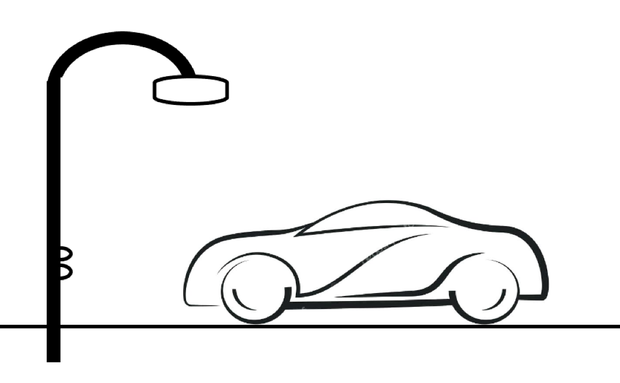
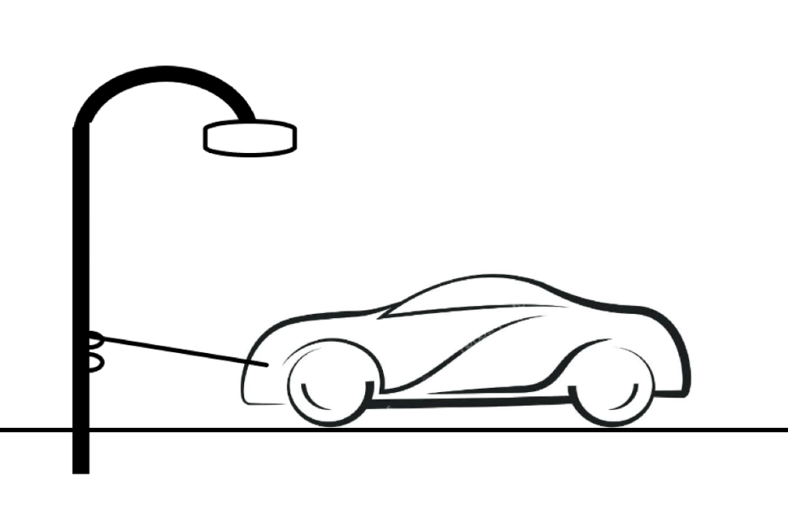
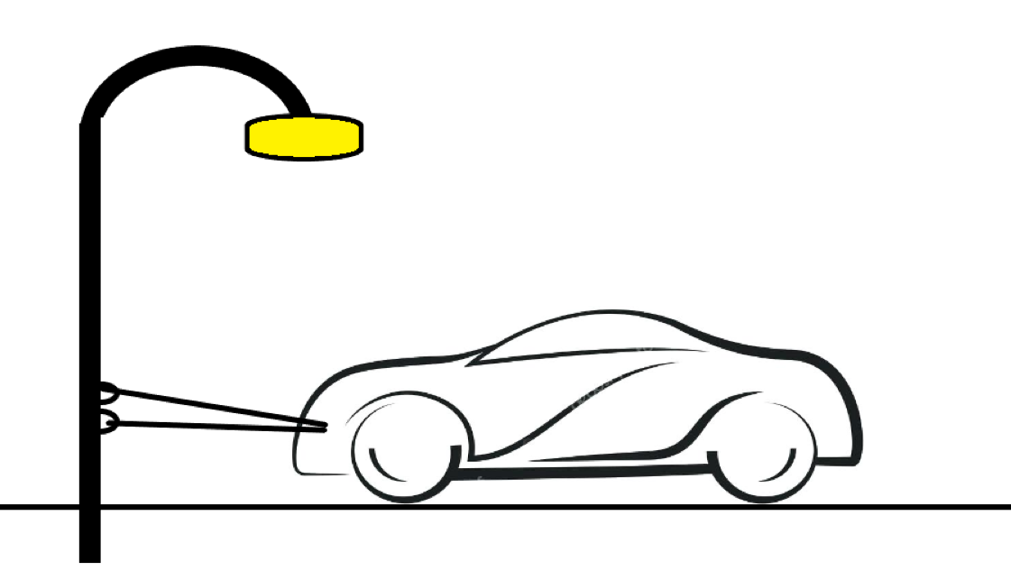
Basic Principle

Slide 6
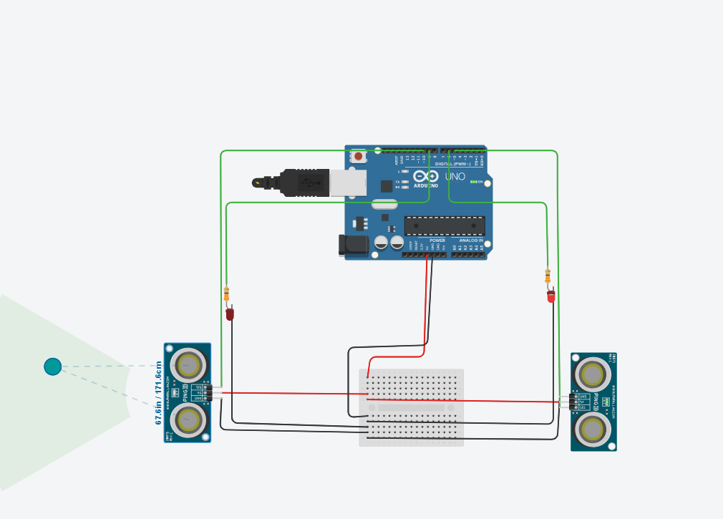
Blind Corner Model

Slide 7
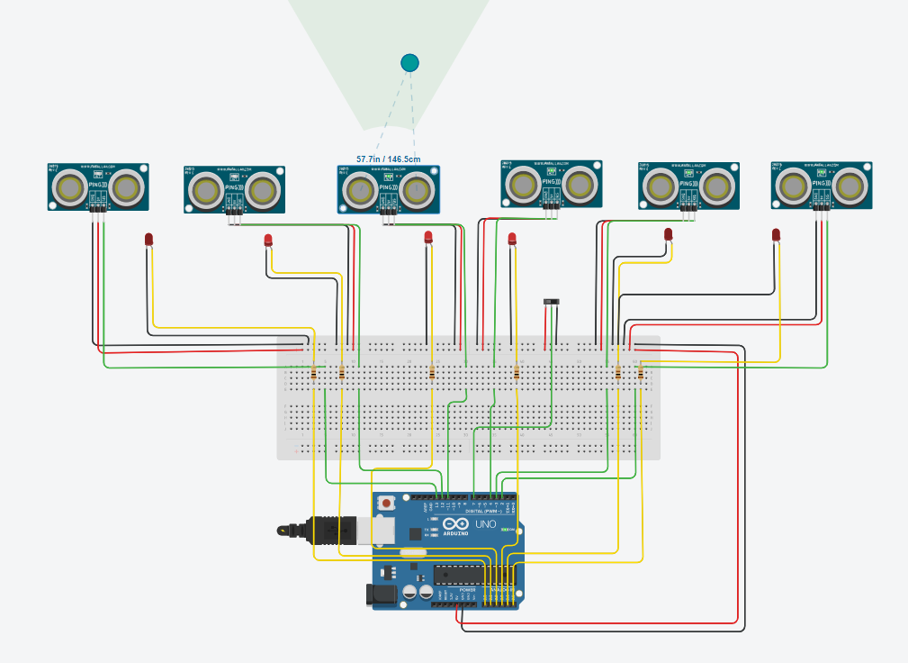
Energy Saving and Vehicle Density

Slide 8
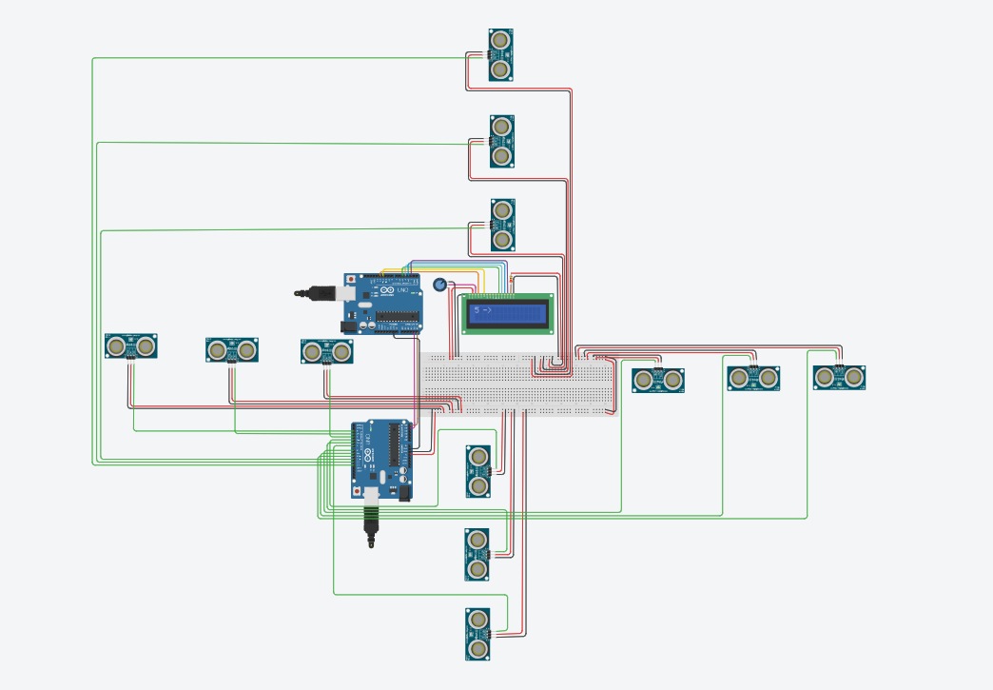
Walker and Driving Control

Slide 9
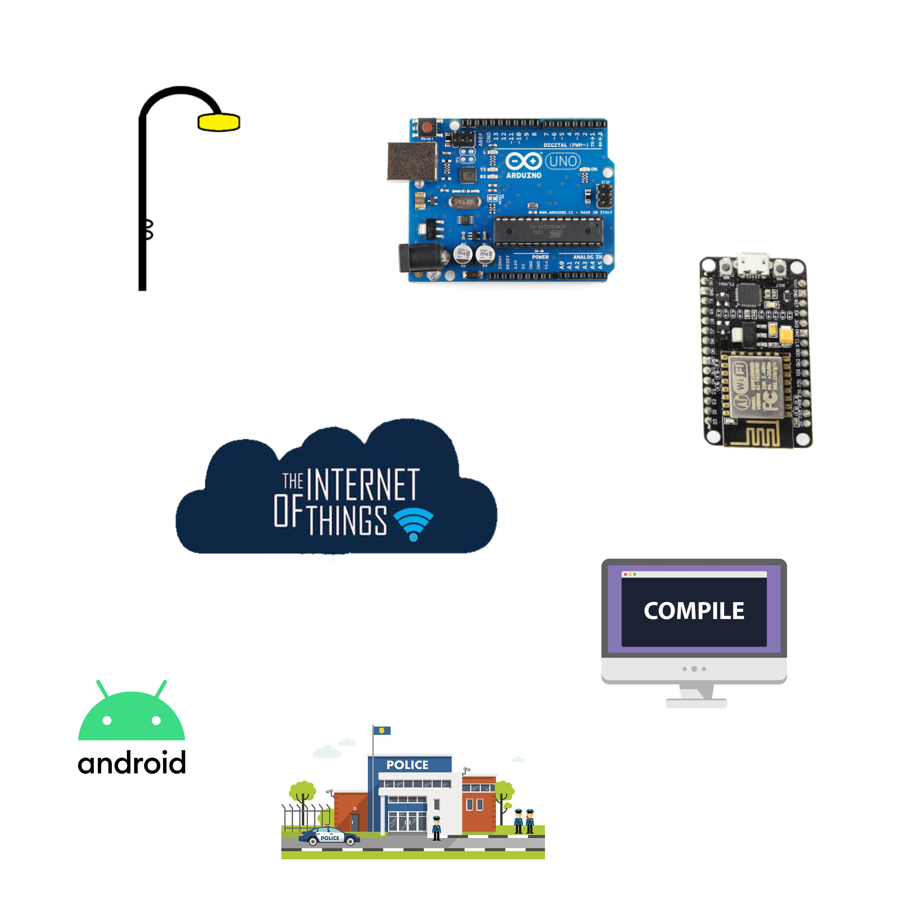
Algorithm

Slide 10
Requirement

Slide 11
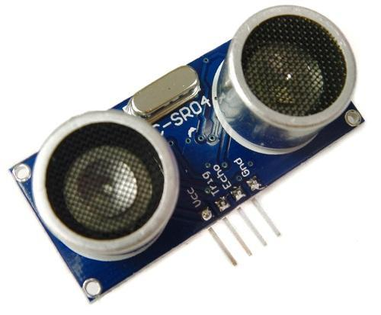
PRODUCT | QUANTITY | COST
ARDUNIO MEGA 2560 | 1 | 1000
ULTRASONIC SENSOR | 15 | 1500
JUMPER CABLE | 100 | 150
LCD DISPLAY | 1 | 400
HEAT AND TEMPERATURE SENSOR | 1 | 250

Slide 12
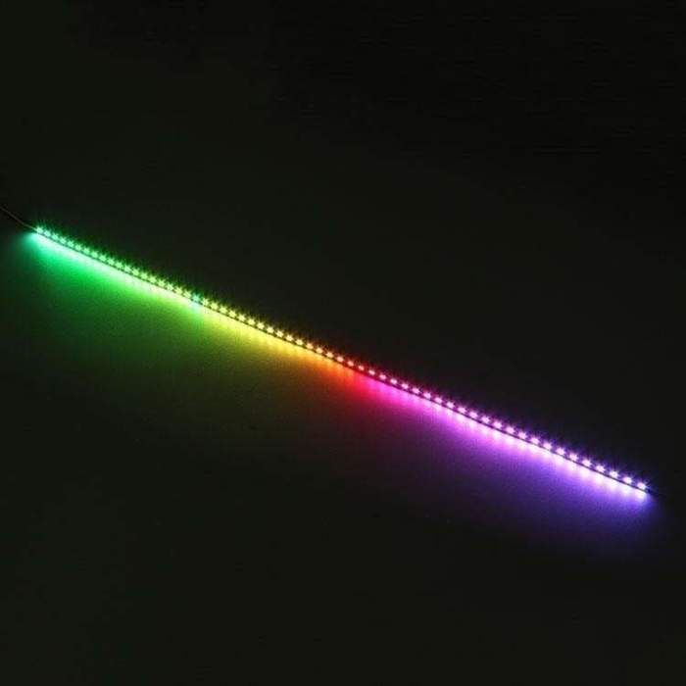
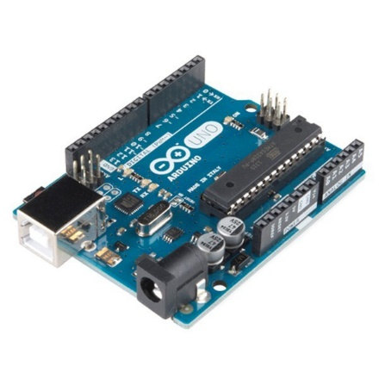
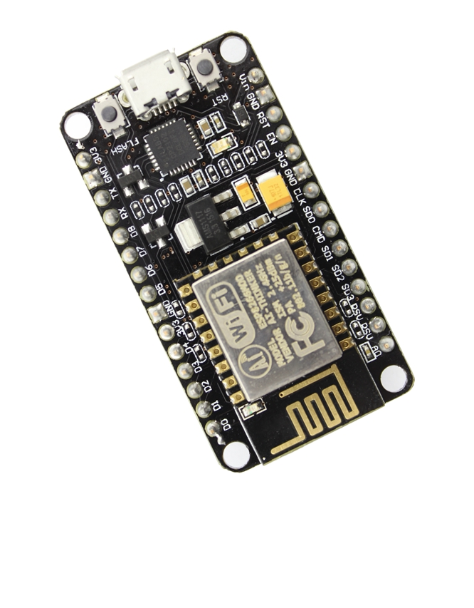

Slide 13

Thank You

